Slide 1
Introduction to Computing
OPERATING SYSTEM

Slide 2
Computer System Structure
Computer system can generally be divided into four parts
Hardware, Software, Data & User.
Hardware – provides the basic computing resources
e.g. CPU, Memory, I/O devices
Software – Two types (Application & System Software)

Slide 3
System software
System software consists of the programs that control or maintains the operations of the computer and its devices
Serves as the interface between the user and the computer’s hardware
Operating system, Device Drivers, Language Processors etc.

Slide 4
Operating System
OS is the computer's master control program
It is a program that acts as an intermediary between a user and computer hardware.
When you issue a command, the OS executes it converting into the instruction, the machine can use.

Slide 5
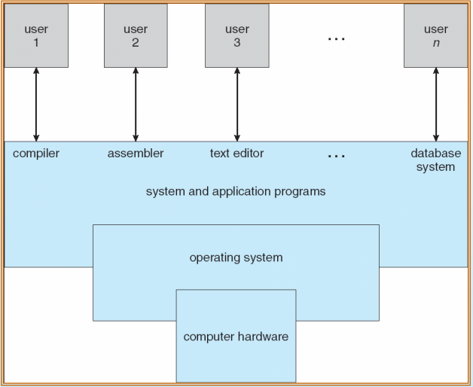
Computer System

Slide 6
Functions of Operating System
An operating system (OS) is a set of programs containing instructions that work together to coordinate all the activities among computer hardware resources
It controls and manages the hardware in tasks as simple as turning starting and shutting down a computer to tasks as managing programs and memory.

Slide 7
Functions of Operating System in a Glance
Start and shut down a computer
Provide a user interface
Manage programs
Manage memory
Coordinate tasks
Configure devices
Establish an Internet connection
Monitor performance
Provide utilities
Automatically update
Control a network
Administer security

Slide 8
Turning on & off
The process of starting or restarting a computer is called booting
Cold Boot
  Turning on a computer that has been powered off completely
Warm Boot
  Using the operating system to restart a computer that is powered on

Slide 9
Turning on & off
Each time you boot up your system, kernel and other operating system instructions are loaded up from storage to RAM.
Kernel is the core part of the operating system.
  Loaded first in main memory and resides in main memory
  Manages memory
  Process Management

Slide 10
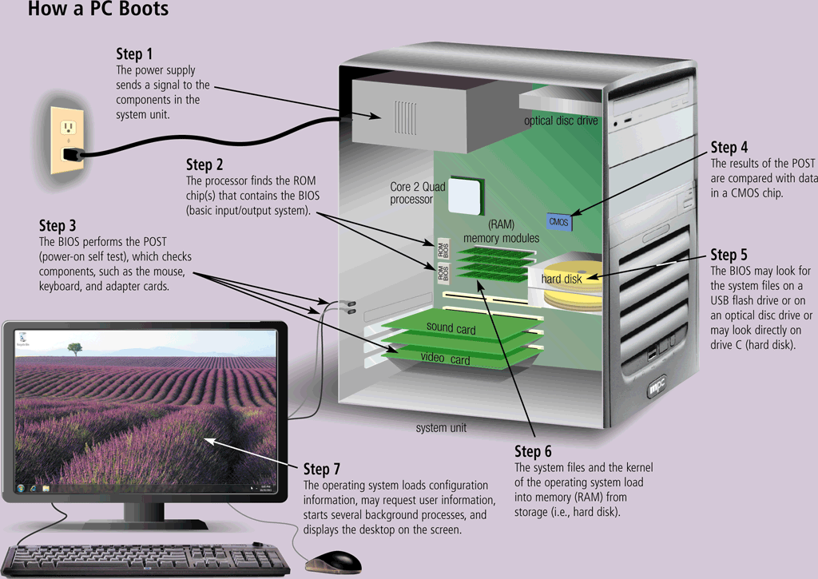
How a system boots up?

Slide 11
Lets shut down the computer
An operating system includes various shut down options
Sleep mode saves any open documents and programs to RAM, turns off all unneeded functions, and then places the computer in a low-power state
Hibernate saves any open documents and programs to a hard disk before removing power from the computer

Slide 12
Providing user interface
A user interface controls how you enter data and instructions and how information is displayed on the screen
With a graphical user interface (GUI), you interact with menus and visual images such as icons and buttons
Most common interface, frees the user from remembering the commands to execute a particular task. Use pointing device and access the desktop metaphor.

Slide 13
Command line Interface - CLI
Older interface
  DOS, Linux, UNIX
With a command-line interface, a user uses the keyboard to enter data and instructions
User types commands at a prompt
User must remember all commands

Slide 14
Managing Programs
How the OS manages programs greatly affects the productivity of user.
Program in execution is called a process.
Manages resource allocation among the processes.

Slide 15
Managing Memory
Functionality of operating system to move the processes back and forth between the RAM and storage devices.
Memory management optimizes the use of RAM
Virtual memory is a portion of a storage medium functioning as additional RAM

Slide 16
Coordinating Tasks
The operating system determines the order in which tasks are processed
This is one of the main functionalities of OS, task scheduling.
Common algorithms used to schedule tasks are FCFS (First come first serve), SJF (Shortest job first) etc.

Slide 17
Device Configuration
A device driver is a small program that tells the operating system how to communicate with a specific device
Plug and Play operating system automatically configures new devices as you install them

Slide 18
Internet Configuration & Performance Monitoring
Operating systems typically provide a means to establish Internet connections
A performance monitor is a program that assesses and reports information about various computer resources and devices

Slide 19
Utilities
Operating system provides utilities such as file management, search utility etc.
Allows to add, copy, delete, rename and search files in folders.
Viewing images and other graphical content in image viewer. Uninstalling programs and associated entries of a file.

Slide 20
Automatic Updates
Provide the user with new upcoming updates to upgrade the system for the access of new features.
Application programs are upgraded to be compatible with new operating systems. They may or may not be compatible with upgrading versions of OS.

Slide 21
Working with Servers
Some operating systems are designed to work over a network.
Server operating systems organize and coordinates how multiple users can access and share resources over a network environment.
Network administrator uses the network operating system to add, remove users and other devices.

Slide 22
Types of Operating System (OS)
Operating systems can be categorized into four types.
Operating system can support real time processing and quick transaction and response.
Operating system can support single user or multi-user
Operating system can support single tasking or multi-tasking.

Slide 23
Real Time OS – RTOS
RTOS are quick responding systems and are characterized by supplying immediate response.
Large number of tasks are performed in short time.
Limited swapping of processes from main to secondary memory.
Common examples are time constraint systems mainly the defense applications like RADAR etc.

Slide 24
Single User – Single Task OS
An OS that allows single user to perform single task.
A user looks at the task as opening a file, printing a document, downloading data etc.
OS looks at a task as a process.
MS DOS

Slide 25
Single User – Multi Task OS
An OS that allows single user to perform multiple tasks.
The OS keeps two or more tasks or processes running at the same time.
Commonly used PCs come with OS such as windows, Mac-OS etc.
Improve productivity of user as more things get done in less time.

Slide 26
Multi User – Multi Task OS
An OS that allows multiple users to perform multiple tasks.
These tasks are simultaneously running over a network server.
Unlike to access files over a network, each user acts a terminal which is accessing the main server through its independent session & all of the computation is done at the server end.
Examples of MU/MT are UNIX, Mainframe OS etc.

Slide 27
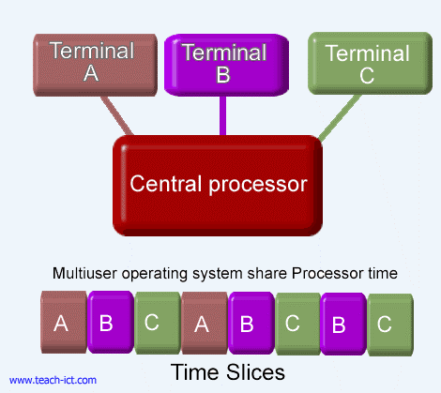
Multi User – Multi Task OS

Slide 28
PC Operating Systems
Most widely used among the computing technology.
Single User Multi task operating systems are utilized.
Windows holds the overwhelming majority where as Macintosh comes second followed by Linux.

Slide 29
PC Operating Systems
Most widely used among the computing technology.
Single User Multi task operating systems are utilized.
Windows holds the overwhelming majority where as Macintosh comes second followed by Linux.
Different types of OS and their evolution through time is given in Chapter 6B
(Reading Assignment)

Slide 30
Network Operating Systems
Operating systems designed to run on a network server providing various services to the clients.
Clients run a client based software to request for those services.
Common examples of NOS are Windows Server Editions, Linux for Servers, UNIX for Servers etc.
Client based software are web browsers, email clients, BitTorrent etc.

